Slide 1

Object Oriented Programming in Python

Slide 2
Introduction to Object Oriented Programming
Object-oriented programming (OOP) is a programming paradigm that organizes data and code into reusable objects.
Key concepts in OOP include encapsulation, inheritance, polymorphism, and abstraction.
OOP promotes modular and reusable code, making it easier to design and maintain complex software systems.

Slide 3

Advantages of Using OOP over Procedural Programming
Modularity: OOP allows for modular design by breaking down a system into smaller, self-contained objects.
Reusability: Code can be reused through inheritance and object composition, reducing redundancy and improving efficiency.
Maintainability: OOP's modular structure and encapsulation make it easier to understand, modify, and debug code.
Scalability: OOP provides a flexible and scalable approach for managing complex systems as they can be extended and modified with ease.
Abstraction: OOP promotes the use of abstract classes and interfaces, which hide complex implementation details and focus on essential functionality.

Slide 4
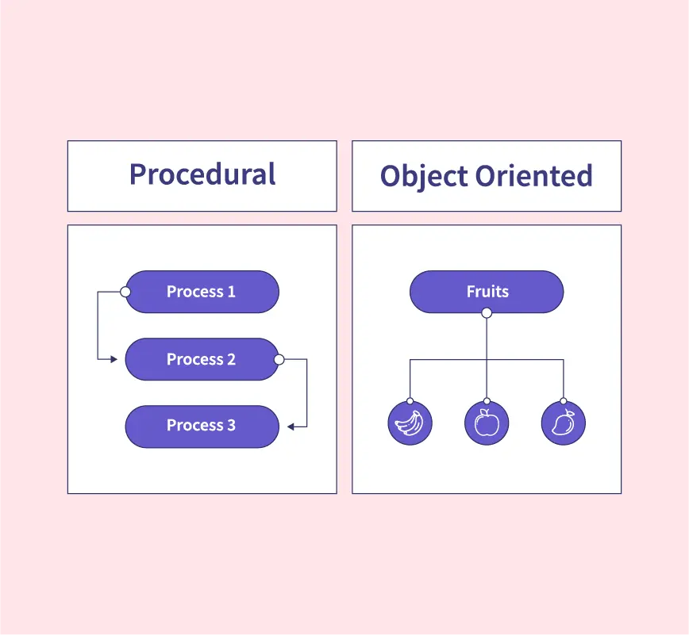
Procedural vs Object Oriented Programming

Slide 5
Comparison between OOP and Procedural Programming
Procedural Programming: Focuses on procedures and functions that manipulate data, with code organized around procedures.
OOP: Focuses on objects and their interactions, with code organized around objects and classes.
OOP enables better code organization, reusability, and maintenance compared to procedural programming.
Procedural programming may be simpler for small, straightforward tasks, while OOP is more suitable for large and complex systems.

Slide 6
Class
Classes are blueprints or templates for creating objects.
A class defines the attributes (data) and methods (behavior) that objects of that class will possess.
In Python, classes are defined using the class keyword.

Slide 7
The __init__ method
The __init__ method is a special method in Python classes that is automatically called when an object is created.
It is used to initialize the attributes of an object with specific values.
Similar to constructors in other programming languages

Slide 8
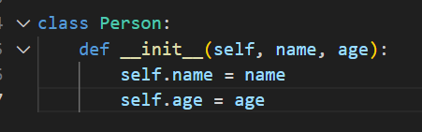
Example of a class
Consider a class called Person with attributes name and age.
The __init__ method can be used to set these attributes when creating a new Person object.
When a Person object is created, the __init__ method is automatically called, initializing the attributes with the provided values.
The __init__ method enables us to conveniently set up the initial state of objects, making it a fundamental part of object initialization in Python.

Slide 9
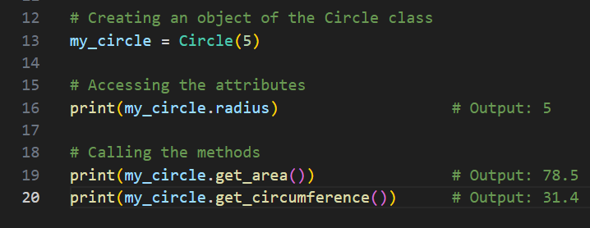
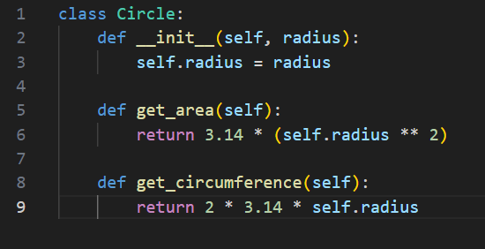
Explanation of components
class Circle:: Defines a class named Circle.
def __init__(self, radius):: The __init__ method is a special method called the constructor. It is executed automatically when an object of the class is created. In this case, it takes a parameter radius and assigns it to the instance variable self.radius.
self.radius: This is an instance variable, which means it holds data specific to each instance of the class (each circle object will have its own radius value).
def get_area(self):: This is a method defined within the class. It calculates and returns the area of the circle based on its radius. The self parameter is a reference to the instance of the class, allowing us to access the instance variables.
def get_circumference(self):: This is another method defined within the class. It calculates and returns the circumference of the circle based on its radius

Slide 10
Objects
Instance of a Class: An object is created from a class. It follows the structure and behavior defined by the class but has its own specific values for attributes.
State: Objects have a state represented by their attributes or instance variables. These variables hold data specific to each object.
Behavior: Objects can perform actions or exhibit behavior through methods defined in the class. Methods define what the object can do or how it can interact with other objects.
Identity: Each object has a unique identity that distinguishes it from other objects. This identity is typically assigned automatically when the object is created.
Encapsulation: Objects encapsulate both data (attributes) and behavior (methods) within a single entity. This encapsulation provides a way to bundle related data and functions together, making code more modular and organized.
Interactions: Objects can interact with each other by invoking methods, accessing attributes, or passing messages. These interactions allow objects to collaborate and perform complex operations.
Data Abstraction: Objects provide a way to abstract complex data structures and operations into manageable and reusable entities. They help to model and represent real-world entities in a more intuitive and organized manner.

Slide 11
Types of variables in a class
Instance Variables
Class Variables
Local Variables

Slide 12
Instance Variables:
Associated with individual objects of a class.
Each object has its own copy of instance variables.
Their values can vary between different objects.
Accessed using the self keyword within methods.

Slide 13

Class Variables
Shared among all objects of a class.
Declared within the class but outside any method.
Commonly used for storing constants or shared data.
Accessed using the class name.

Slide 14
Local Variables
Declared and used within a specific method or function.
Exist only during the execution of that method.
Not accessible outside the method.
Used for temporary storage or calculations.

Slide 15
Types of methods in a class
Instance Methods
Class Methods
Static Methods

Slide 16
Instance Methods
Defined within a class and operate on individual objects.
Access instance variables and modify the state of an object.
Accessible using the object of the class.
The first parameter is usually self to refer to the object itself.

Slide 17
Class Methods
Associated with the class rather than individual objects.
Accessed using the class name.
Can access and modify class variables.
Defined using the @classmethod decorator.
The first parameter is usually cls to refer to the class itself.

Slide 18
Static Methods
Not specific to objects or the class itself.
Independent of the state of objects or class variables.
Defined using the @staticmethod decorator.
Used for utility functions that don't require access to instance or class-specific data.
Accessed using the class name or object.

Slide 19
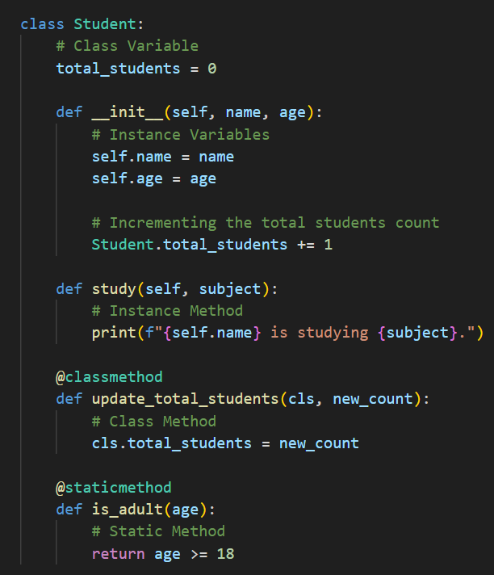

Slide 20
Everything is an object in python
In Python, every entity, including basic data types, functions, and classes, is treated as an object.
Objects in Python have attributes and methods associated with them, allowing for data manipulation and behavior definition.
This object-oriented nature of Python provides code reusability, modularity, and the ability to organize related data and functions.
Understanding that everything is an object in Python enables developers to leverage the language's features effectively and embrace object-oriented programming principles.

Slide 21
Pillars of Object Oriented Programming
Encapsulation
Inheritance
Polymorphism
Abstraction

